Slide 1

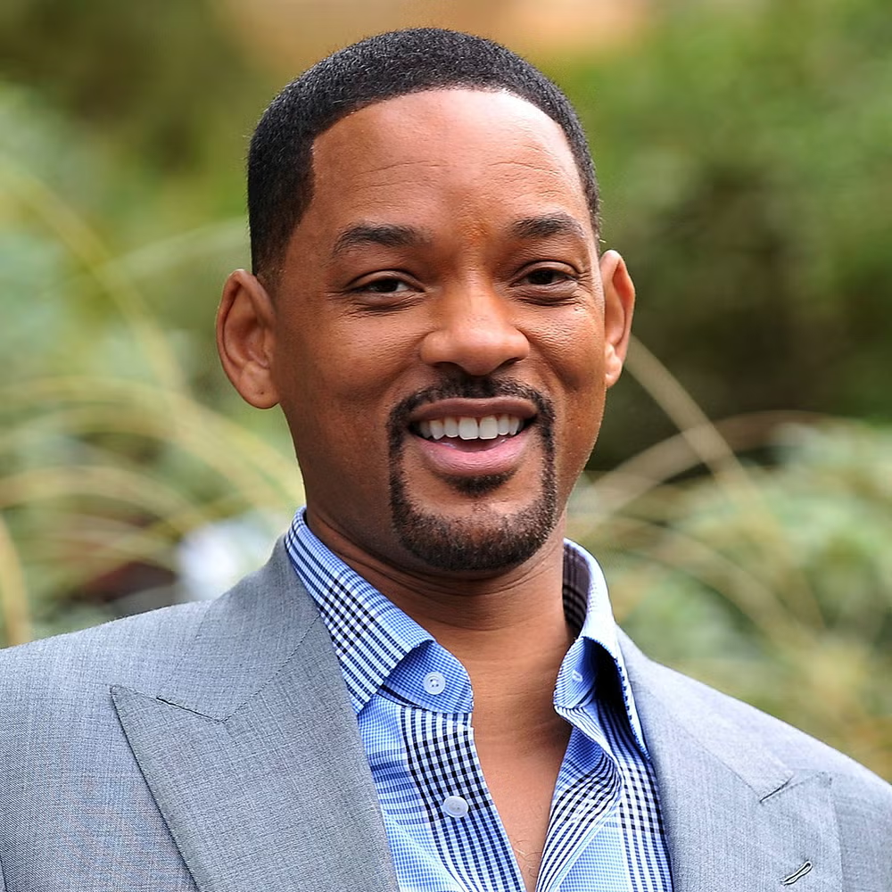
Will Smith
Tercera evaluación en Proceso
From Alexander Rayo

Slide 2
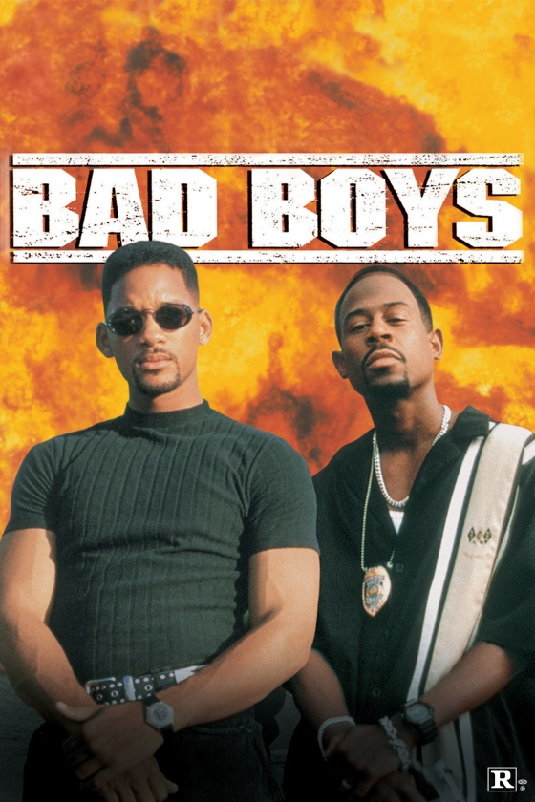
Life
Is a Rich actor and rapper, he has three sons, Jaden Smith, Trey Smith and Willow Smith, his wife is jada Pinkett Smith, he was born on Filadelphia, Pensilvania in United States from America on September 25 of 1968, he right now has 56 years old, he has a few films in which he has participated like Bad Boys for life, Yo robot, Suicide Squad, Aladdin, student of the year 2 among others, he has colaborated with a lot of artist like Bad Bunny, Nicky Jam, Marc Anthony, India Martinez among others

